Slide 1
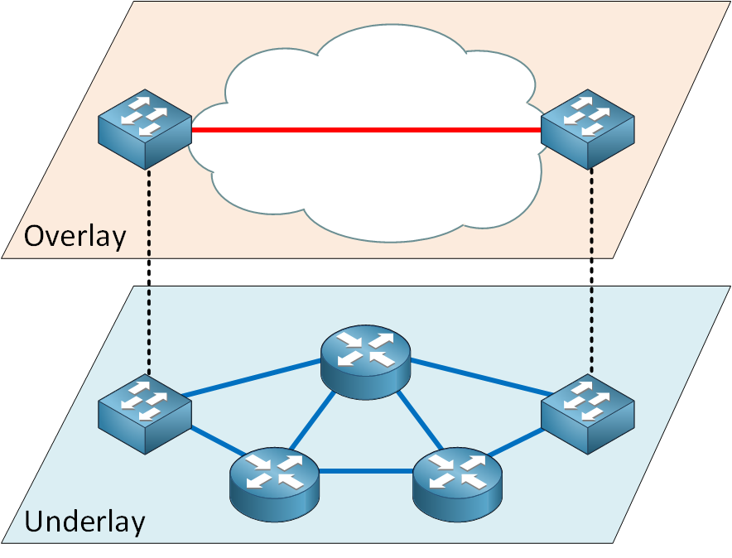
Overlay vs Underlay Networks

Slide 2
Overview
An Underlay network is the physical network responsible for the delivery of packets like DWDM (Dense wavelength-division multiplexing), L2, L3, MPLS (Multiprotocol label switching), or internet, etc.
An overlay is a logical network that uses network virtualization to build connectivity on top of physical infrastructure using tunneling encapsulations such as VXLAN (Virtual Extensible LAN), GRE, IPSec.

Slide 3
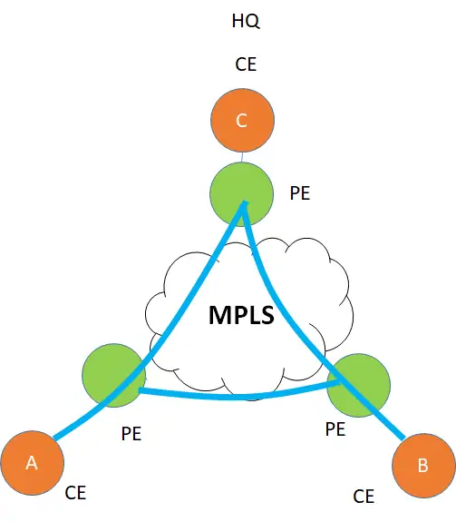
Underlay example
A common physical infrastructure, for example, a WAN network, In which a customer has three sites A, B, C with the C as the HQ which are all physical devices.
There is a layer 3 IP/MPLS VPN between the 3 sites which is the underlay for this customer.
This is a Peer-based VPN, which means that the CE ( Customer Edge) peers with PE ( Provider Edge router), exchange routes, and then how the routes are advertised between the PE is the responsibility of the MPLS provider and not the customer who owns CE.
Once CE handovers traffic to PE, it forgets on how it is transported inside the Provider network and which route it takes.

Slide 4
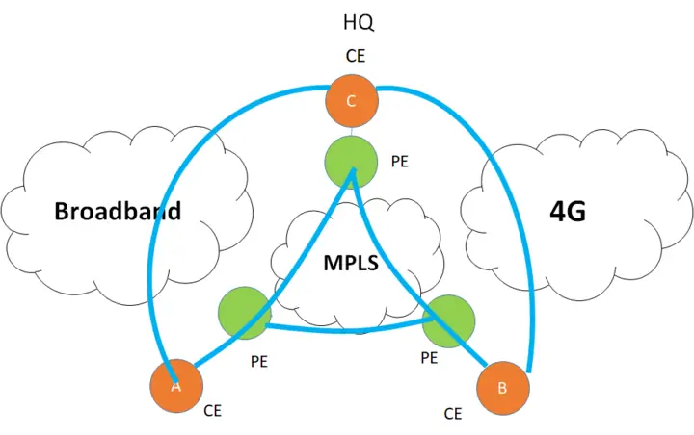
Underlay example
Aside from the Traditional MPLS network, there are two more network types, A broadband network and the 4G network. The need is to use these “low cost” transport networks to offload some of the data from the MPLS network ( if not all)

Slide 5
Issues with Underlay networks
Issue 1: The Internet cannot be used as an underlay for private traffic
One issue is that internet medium natively is insecure so it cannot be used as an underlay for private traffic. To protect it we will need to use security protocols like IPsec. IPsec is a tunneling protocol. Which is an overlay.
Issue 2: Multi-Path forwarding
The customer wants load balancing by combining underlays of different types. However, it is very complex ( if not impossible) to use multiple underlays which are of different types, simultaneously to forward traffic from source to destination
If we stick with the underlay, it can restrict us in multiple ways.

Slide 6
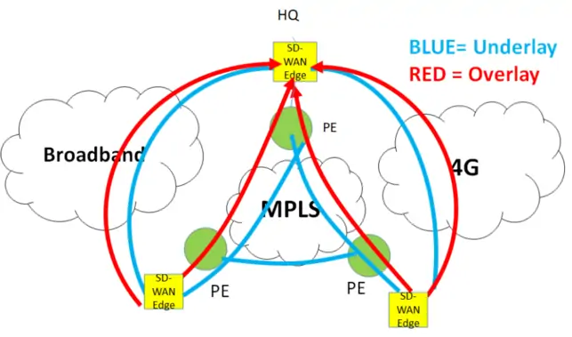
Overlay Network
Overlays are software-based and not dependent on transport. It’s like a virtual network ( virtual links) on top of the physical network. This virtual network needs to have underlay created first.
Create an underlay once and forget it. Now create overlays on top of it and since they are software-based. changing the configurations is super easy and friendly. Underlay is a pipe on which overlays run. The intelligence is all in the overlay.
However, to have overlays in SD-WAN, we will need a special CPE (Customer Premises Equipment) called SD-WAN edge device. These overlay nodes are installed at all the sites.

Slide 7
How Overlays are formed
A GRE (Generic routing encapsulation) tunnel is formed by a SD-WAN Edge Device. The edge device adds a GRE tunnel header with a new IP header and masks the inner IP header from the MPLS domain, the MPLS forwards based on the outer IP header.
Once the packet reaches its destination, the SD-WAN edge removes the outer IP header and the Tunnel header and what we get is the original IP packet. During all this process the overlay is not aware of the underlay.
The same process can be done for the internet underlay but with the addition of encryption using IPSec. All this can be done seamlessly using the same SD-WAN Edge box.

Slide 8
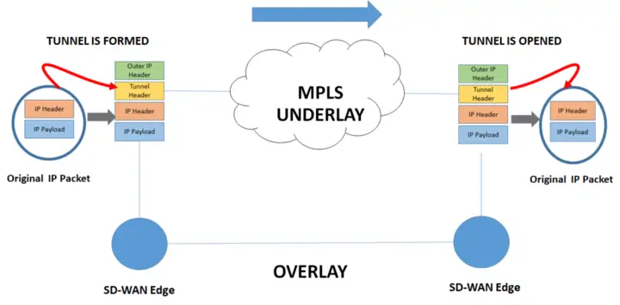
The overlay is formed once encapsulation happens at the left SD-WAN box and ends when the header is removed at the destination. The overlay is not aware of the underlay on which it is riding. The underlay here is MPLS but it can be any other type of transport.

Slide 9


Questions

